Slide 1
Cloud Compute & Storage
Nationwide
Drake Pocsatko
Kadambari Athreya

Slide 2



Instructors
Kadambari Athreya
Cloud Success Team – Consulting
14 yrs. in IT
Nationwide since 2012
Drake Pocsatko
Pittsburgh, PA born and raised
OSU Grad ‘19
Cloud Infrastructure Engineering Team

Slide 3
What you will learn
Theory
Intro to Cloud
Some of the AWS Services
Cloud networking
Cloud security and encryption
Introduction to S3; IAM; EC2; KMS;
Labs
S3 buckets
Building EC2
Create an IAM role and add it to the EC2 instance
Running CLI Command on EC2

Slide 4
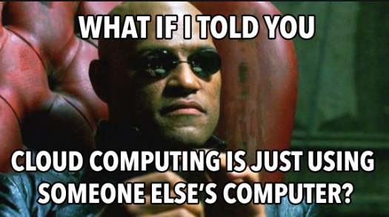
Cloud computing
WHAT
Compute ( Servers. Storage, db, networking, software etc.) over the internet
Pay as you need model
WHY
Speed to delivery – Through Automation
LOWER COSTS
Only pay for what you use;
Less Operational Over-Head
HIGH reliability and performance – AWS SLA
QUICKLY scalable – No need to over-provision
WHO
Amazon web services
Azure
Google cloud platform

Slide 5
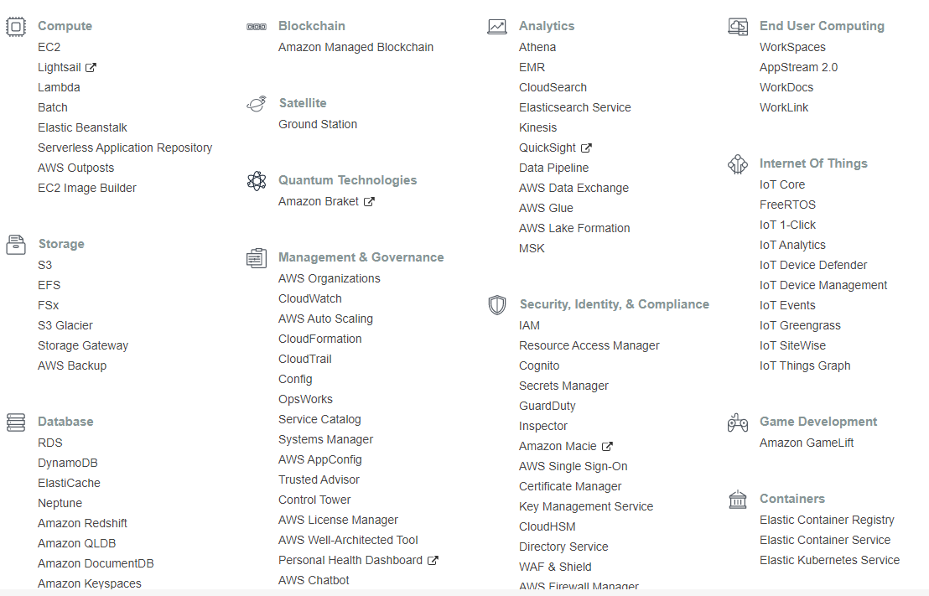
AWS Services

Slide 6
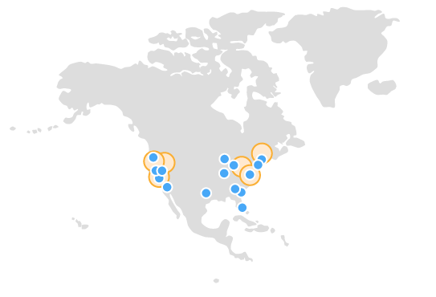

RegioNs
AWS Region - is a physical location around the world where AWS has clusters of data centers.
Ref: https://aws.amazon.com/about-aws/global-infrastructure/regions_az/

Slide 7
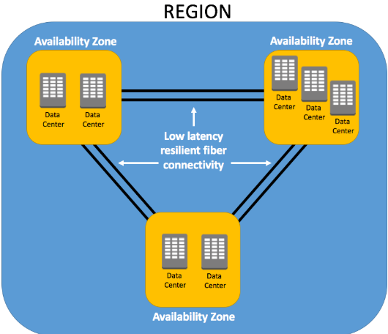
AVAILABILITY Zones
Availability Zones(AZ) are distinct locations within an AWS Region that are engineered to be isolated from failures in other Availability Zones (AZ).
They provide inexpensive, low-latency network connectivity to other Availability Zones (AZ) in the same AWS Region.
Each AZ is comprised of multiple data centers
Ref: https://cloudacademy.com/blog/aws-global-infrastructure/

Slide 8
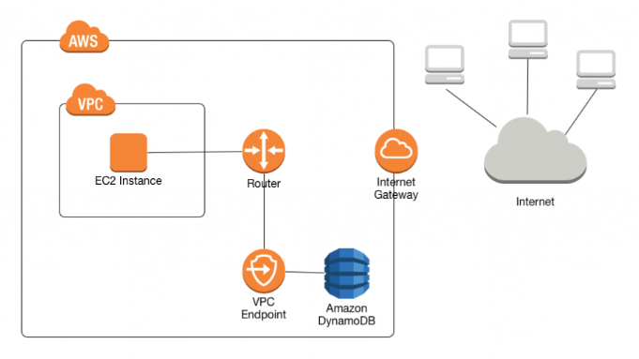
Networking
A virtual private cloud (VPC) is a virtual network dedicated to your AWS account.
A subnet is a range of IP addresses in your VPC.
A VPC endpoint enables you to privately connect your VPC to supported AWS services.
Traffic between your VPC and the other service does not leave the Amazon network.
Adding AWS Services to VPC also gives you access to On-Prem
Reference : AWS

Slide 9
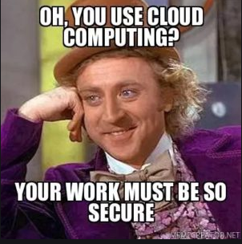
SECURITY

Slide 10
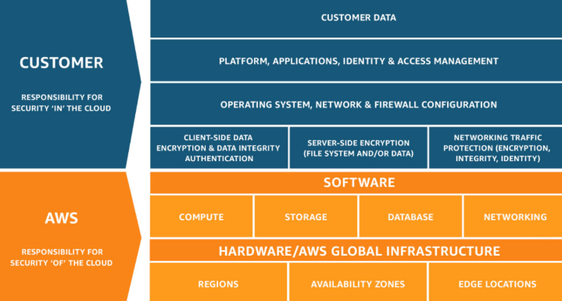
SECURITY - responsibility
https://aws.amazon.com/compliance/shared-responsibility-model/

Slide 11
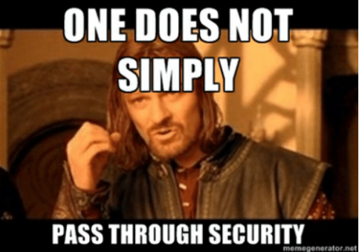
security
USERS – Local users
GROUPS – Collection of users
ROLES - An IAM role is an AWS Identity and Access Management (IAM) entity with permissions to make AWS service requests
FEDERATED ROLES
RDS-POWER-USER
TEAM-ROLES
POLICY – JSON File :
Document of Rules and apply it to users; groups; Roles; Services
TRUST RELATIONSHIPS
RESOURCE-BASED POLICIES
IAM BASED POLICIES

Slide 12
SECURITY – Security GROUPS & encrytion
SECURITY GROUPS – a.k.a Firewall
Ports Open
IP range open
E.g. Can’t SSH to your EC2 check if the correct port is open and correct IP range
ENCRYPTION
Encryption at Rest
Encryption in Transit
Notes:
Encrypt everything
Only give access to what is needed
Use Purpose built Roles
Do not create a single super user role
Create separate roles with defined access

Slide 13
S3 - Simple Storage Service
S3 – https://aws.amazon.com/s3/
Amazon Simple Storage Service (Amazon S3) is an object storage service that offers industry-leading scalability, data availability, security, and performance.
The Cost associated with S3 depends on usage and the class you use
Bucketnames have to be unique with AWS. No Public Buckets
Storage Class | Description
S3 Standard | General purpose storage for any type of data, typically used for frequently accessed data
S3 Intelligent – Tiering | Automatic cost savings for data with unknown or changing access patterns
S3 Standard - Infrequent Access | Automatic cost savings for data with unknown or changing access patterns
S3 One Zone - Infrequent Access | For re-creatable infrequently accessed data that needs millisecond access
S3 Glacier | For long-term backups and archives with retrieval option from 1 minute to 12 hours
S3 Glacier Deep Archive | For long-term data archiving that is accessed once or twice in a year and can be restored within 12 hours

Slide 14
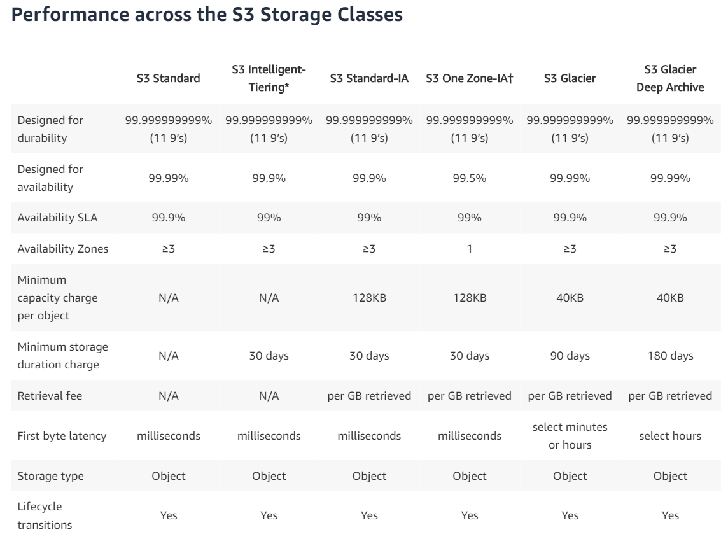

Slide 15
EC2
EC2 – https://aws.amazon.com/ec2/
Amazon Elastic Compute Cloud (Amazon EC2) is a web service that provides secure, resizable compute capacity in the cloud. It is designed to make web-scale cloud computing easier for developers.
Advantages
Elasticity – No more over-provisioning for peak usage.
Cost Savings – Only pay for what you use.
Speed – Deploy in minutes what used to take months.

Slide 16
Key Management System (KMS)
AWS Key Management Service (KMS) - https://aws.amazon.com/kms/
Used to create and manage cryptographic keys
KMS keys are used across a wide range of AWS services and in your applications
Data in S3 buckets
Encrypt Databases (RDS)
Encrypt storage volumes (EBS)
Types
AWS Managed Keys – Maintained by AWS
Custom KMS Keys – Create and customized by us as needed

Slide 17
LABs
CREATE AN S3 BUCKET
BUILD AN EC2
CREATE AN IAM ROLE
RUN CLI COMMANDS
DON’T FORGET TO DELETE EVEYTHING YOU CREATED IN THESE LABS AFTER YOU ARE DONE.

